Slide 1
Skill Enhancement Course (SEC) T1
Logic and Sets
Prepared by:
Dr. Rima Barik
On 02/09/2023
Department of Mathematics
Khatra Adibasi Mahavidyalaya

Slide 2
Topics to be discussed:
Set Theory:
Introduction to Sets
Types of Sets
Set Operations

Slide 3
Sets
Definition: A set is a well defined collection of distinct objects of our imagination or thought.
Example1: A = {a,b,c,d,e,f}
Example2: B = { a,b, 1,2,3, n,m}
Example3: C = the set of all positive integers
Example4: D = { } = a set having no element

Slide 4
Finite & Infinite Sets
Finite set : A set is called finite if it contains a finite number of elements in it.
Example1: A = {a,b,c,d,e,f}
Example2: B = { a,b, 1,2,3, n,m}
Example3: the set having no element in it = Null Set / Empty Set / $∅$
Infinite set : A set is called infinite if it contains infinite number of elements in it.
Example1: A = { 1,2,3,4,……}
Example2: B = the set of all stars in the sky

Slide 5
Subset
Let A and B be two sets, such that
$x∈A ⟹x ∈B$
then A is said to be a subset of B.
Example: $A=\{a,b,c\}$ then $P=\left\{a,b\right\}, Q=\left\{b,c\right\}$ are subsets of A.
Null Set is subset of every set
Every set is subset of itself.
All the sets are subsets of universal set.

Slide 6
Subset contd.
A = {a,b}
{ }, {a}, {b}, {a,b} are the all possible subsets of A
Power Set : The Set of all possible subsets of a given set is called the power set of the set.
If a set contains n elements, then its power set contains $2^{n}$ elements.

Slide 7
Set operations
Union : Union of two sets gives a set which contains each and every element present in either of the set.
A $∪$B = { x : x$∈$A or x$∈$B }
Intersection : Intersection of two sets gives a set which contains every element present in both the sets.
A $∩$B = { x : x$∈$A and x$∈$B }

Slide 8
Set operations contd.
Difference / Subtraction : If A and B are two sets, then $A−B = \{x: x∈A \& x∉B\}$.
Complement : For a set A, complement of A is denoted by $A′$ and is defined as $A^{′}=U−A$, where U = universal set.
Symmetric Difference : If A and B are two sets, then symmetric difference of A and B is denoted by $A ∆ B$and is defined as
$$A ∆ B=\left(A−B\right)∪(B−A)$$

Slide 9
Set operations contd.
Cartesian Product : If A and B be two sets then cartesian product of A and B is denoted by
AXB and is defined by
$A X B =\{ \left(a,b\right):a∈A \& b∈B \}$.
Example: If A = { a,b,c} and B = {1,2}, then
AXB = {(a,1),(a,2),(b,1),(b,2),(c,1),(c,2)}
The elements of A X B are called ordered pairs.
(a,1) and (1,a) are not same

Slide 10
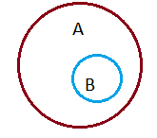
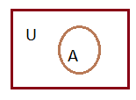
Venn Diagrams
Subset of a Set :
Here, set B is a subset of set A.
The set A is subset of the
universal set U

Slide 11
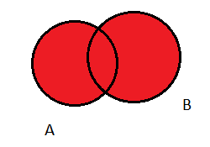
Venn Diagrams contd.
Union of two sets :
A and B are two sets, A $∪$B is the red region.

Slide 12
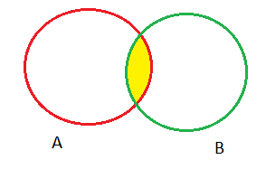
Venn Diagrams contd.
Intersection of two sets A $∩$B
Intersection of two sets A and B is A $∩$B and is shown as the yellow region.
If two sets have no element in common, they are called disjoint sets

Slide 13
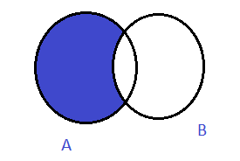
Venn Diagrams contd.
Difference of two sets :
A-B is denoted by the blue region

Slide 14
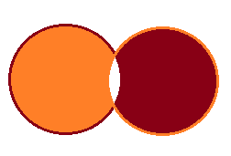
Venn Diagrams contd.
Symmetric Difference of two sets :
It includes the entire region except the common one.

Slide 15
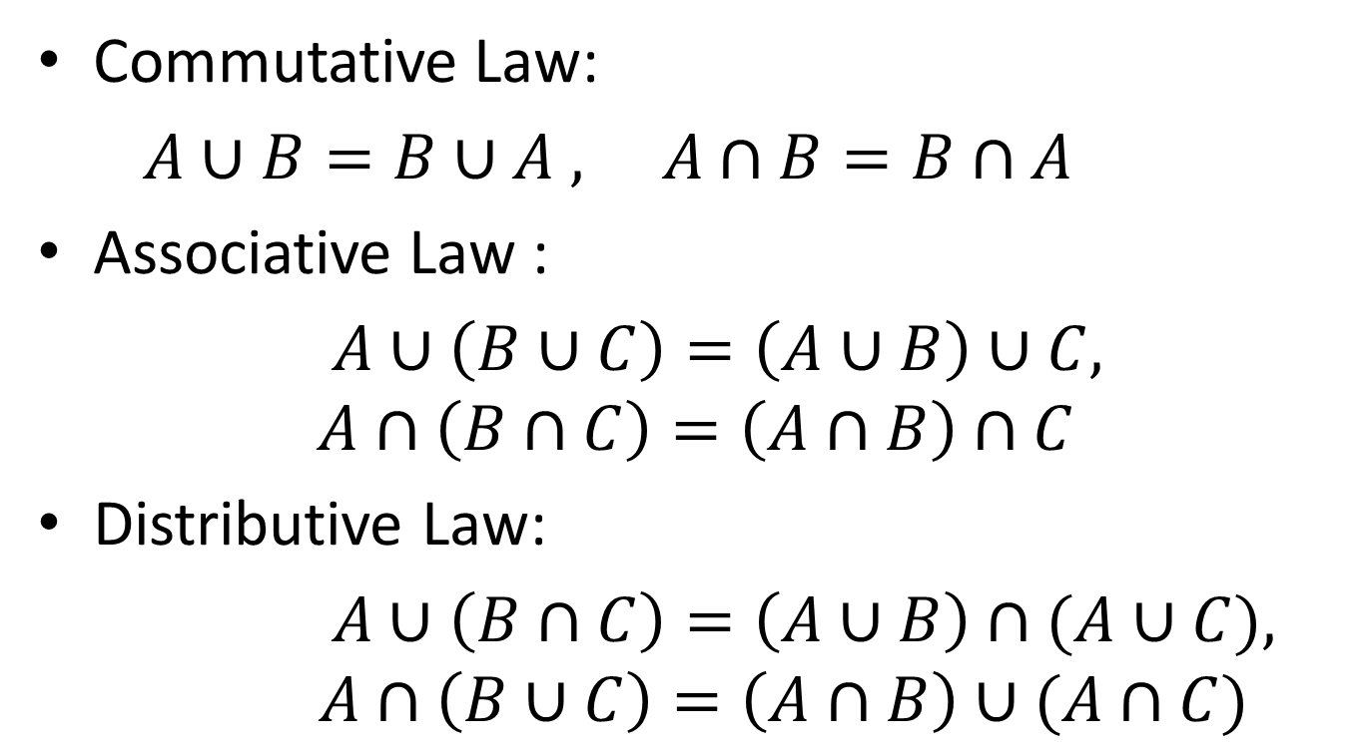
Set Identities
Commutative Law:
$A∪B=B∪A , A∩B=B∩A$
Associative Law :
$A∪\left(B∪C\right)=\left(A∪B\right)∪C,$
$$A∩\left(B∩C\right)=\left(A∩B\right)∩C$$
Distributive Law:
$A∪\left(B∩C\right)=\left(A∪B\right)∩(A∪C),$
$$A∩\left(B∪C\right)=\left(A∩B\right)∪(A∩C)$$

Slide 16
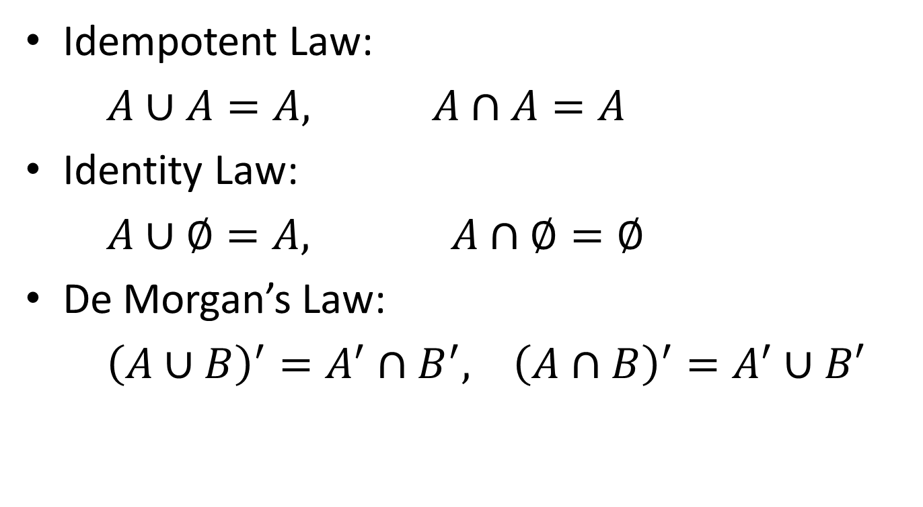
Set Identities contd.
Idempotent Law:
$A∪A=A, A∩A=A$
Identity Law:
$A∪∅=A, A∩∅=∅$
De Morgan’s Law:
${\left(A∪B\right)}^{′}=A^{′}∩B^{′}, {\left(A∩B\right)}^{′}=A^{′}∪B′$

